Slide 1
Intro to the Commercial System Benchmark Python Model

Slide 2
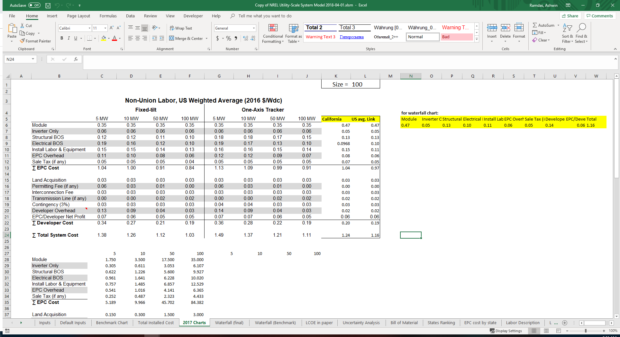
What is the Goal
Goal was to recreate the tables that Ran uses in the final figure.
  A.k.a. the “Final Table”
To organize the input data and make it easier to edit the input data
  Have separate excel files for each category of inputs
To be less cumbersome to run
  User only needs to edit inputs and click run, and the model outputs the results

Slide 3
Model Structure
Input Data
Python Model
Results
Several CSV’s and XLSX’s
User Edits the data in these spreadsheets
Import the Input Data
Intermediate Calculations
Calculations for the Final Table
Export Final Table and Other Results
User should not have to edit unless changing how something is calculated
An XLSX file of various table including the main table as well as associated results

Slide 4
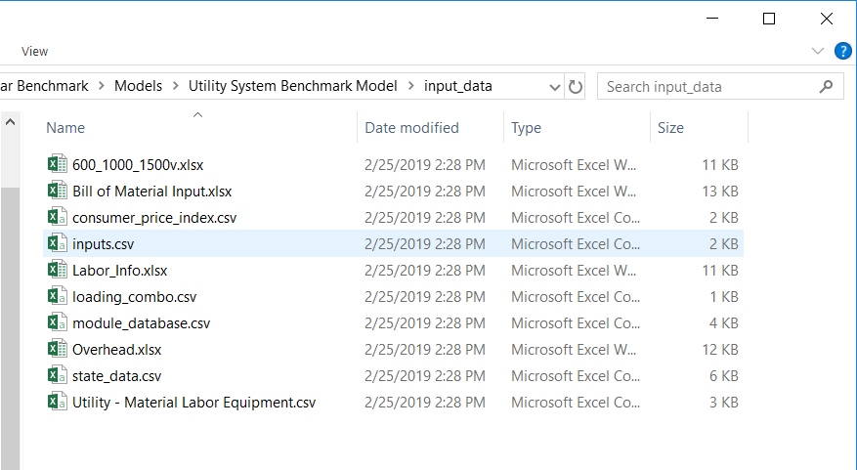
Where is the Input Data
Input data found in the following directory:
  “Commercial System Benchmark Model\input_data”

Slide 5
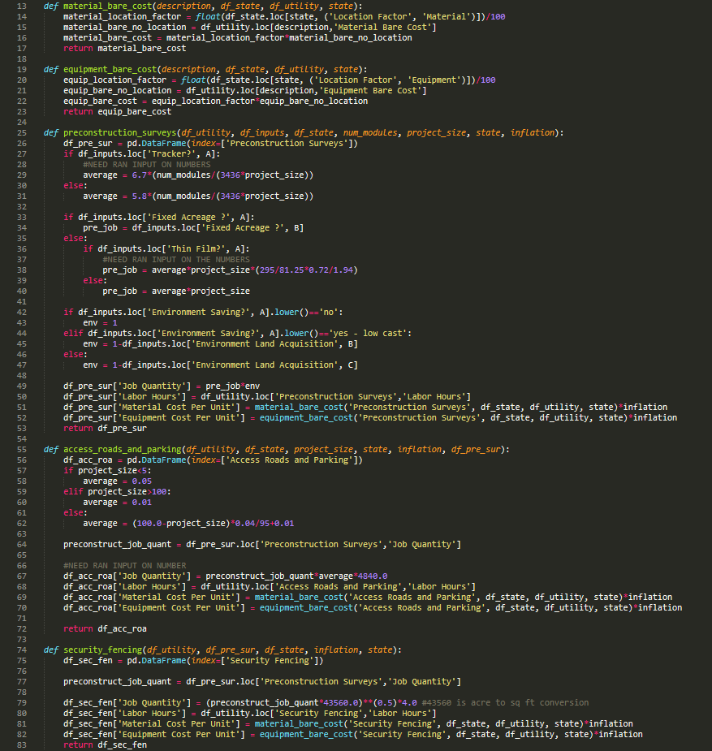
What does the Python Model do?
Automatic update of Labor Database
  Pulls latest average labor costs from BLS
Creates the “Total Installed Cost” table with dozens of functions
  Each row of table has different calculations
Uses the Total Installed Cost values to calculate the Final Table
  Does all the intermediate and final calculations necessary to populate this table

Slide 6
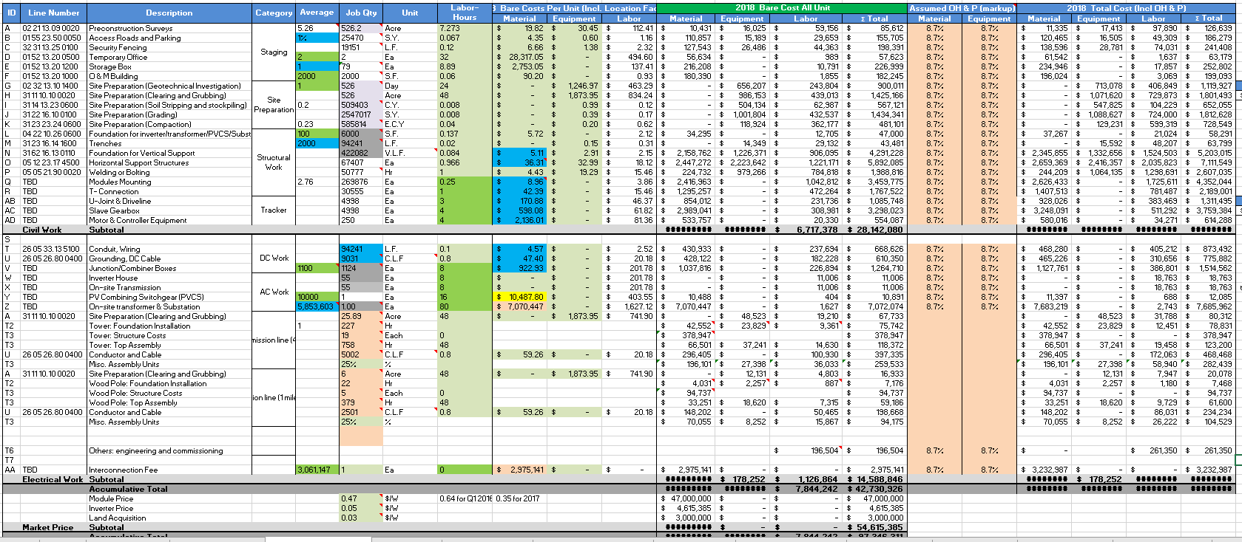
Total installed cost table

Slide 7
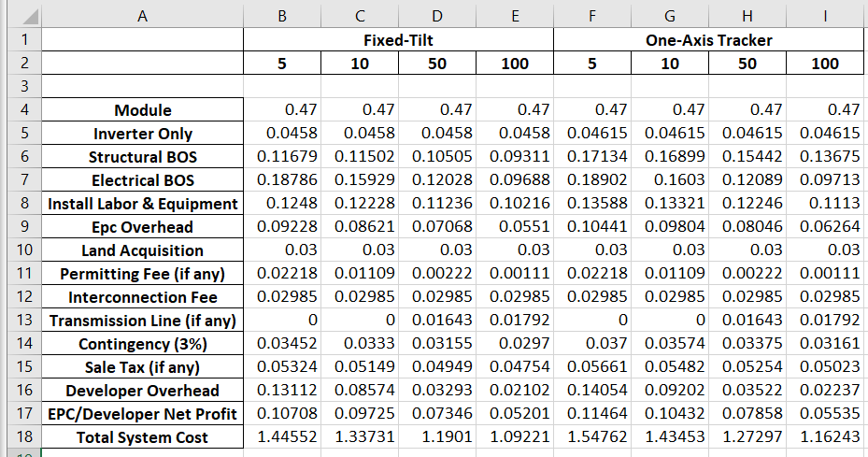
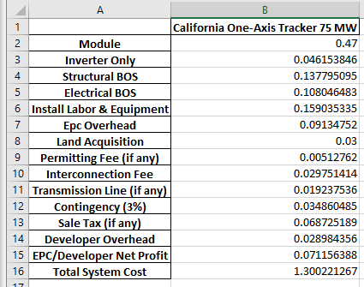
What does it Output
Found in the following directory:
  “Commercial System Benchmark Model\results”
Outputs results of specific location and project size
  Location and project size are specified in input_data
Outputs all state results for Fixed-Tilt and One-Axis Tracker and the four project sizes.
Outputs Figures

Slide 8
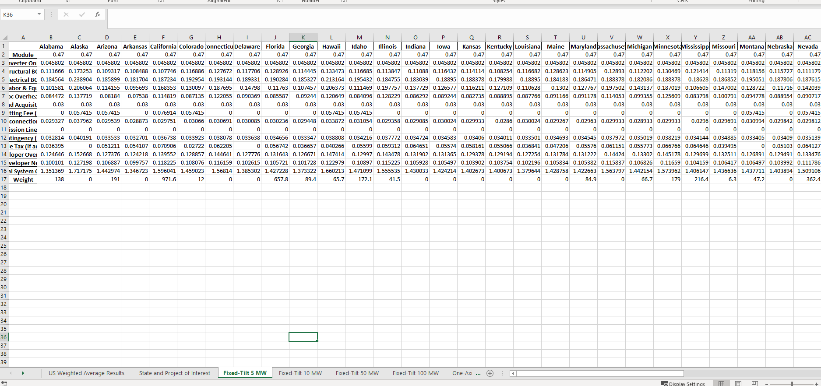
State Level Results

Slide 9
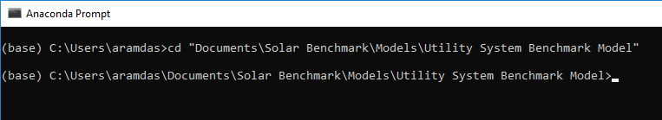
How to Execute
Installing Python
  Installing the Anaconda Navigator
Open Anaconda Prompt
  Click the start button and search “Anaconda Prompt” in the search bar, the app should appear
Navigate to the file where you saved the model
  Type “cd” and then the path of where Commercial System Benchmark Model

Slide 10
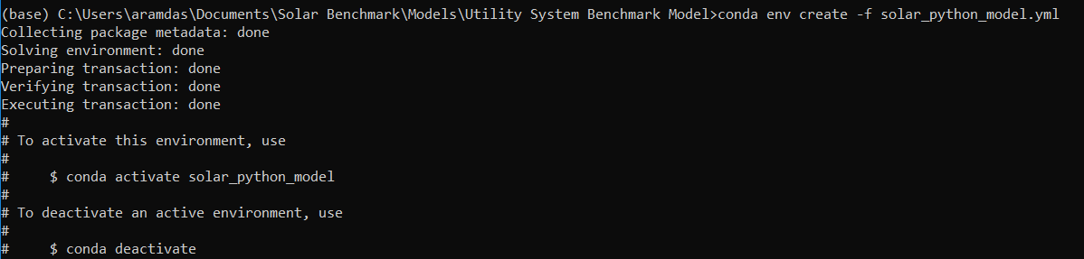
How to Execute
Install the “virtual environment” file
  Type the following into command prompt:
    “conda env create –f solar_python_model.yml” and hit enter
    This will install all the packages that python needs to run the model
Activate the virtual environment
  Type “conda activate solar_python_model” and hit enter

Slide 11
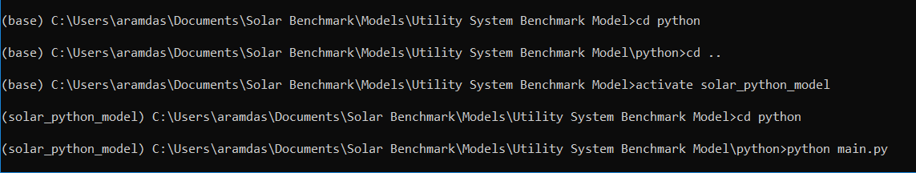
How to Execute
Navigate to the “python” folder in “Commercial System Benchmark Model”
  Type “cd python” and hit enter
Run the model
  Type “python main.py” and hit enter
  “done” message will appear when it is finished as well how many seconds it took to run

